Slide 1
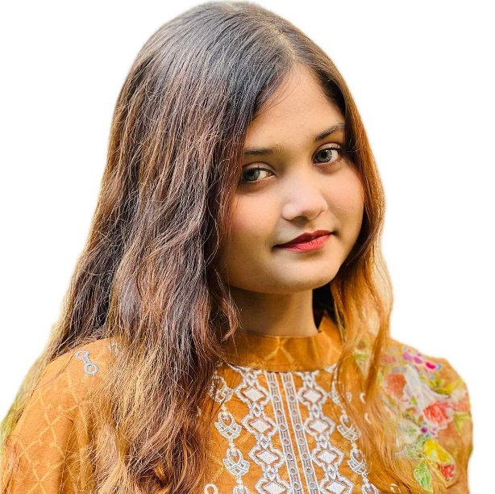



Ariana Anjum
Student
ABOUT ME
EDUCATION
Business Administration student.
I am a responsible and orderly person.
I am looking forward for my first work experience.
INDEPENDENT UNIVERSITY, BANGLADESH
Business Administration
Current
UTTARA HIGH SCHOOL AND COLLEGE
2021
LANGUAGE
Native English.
CONTACT ME
Advanced spanish.
01960616263
COMPUTER SKILLS
arianaanjum@gmail.com
Typing
Uttara,Dhaka
Excel
Slide presentation.
REFERENCE
Dr. Razib Hayat Khan
Assistant Professor
Email; rkhan.iub.edu.bd

